Slide 1

Linear Integrated Circuits EE-411 L1
Dr. Syed Arsalan Jawed
Associate Professor of Practice
Office Hours : W-301, Tuesday/Thursday : 1600-1700
September 02-04, 2025
H-505
!پھربرق فروزاں ہےسر وادی سینا ، اۓدیدہ بینا
The flame of illumination set ablaze…. O’ the beholder of sight!

Slide 2
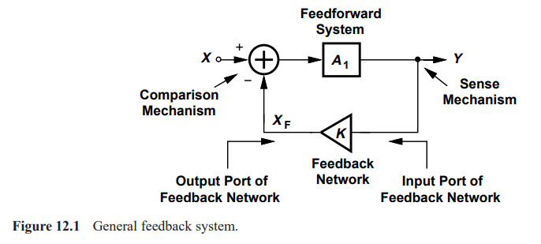
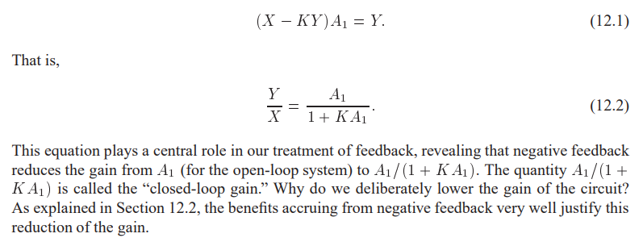
Chapter 12 Feedback , skipping Chapter 11
If K=0, Open Loop System otherwise Closed Loop System

Slide 3
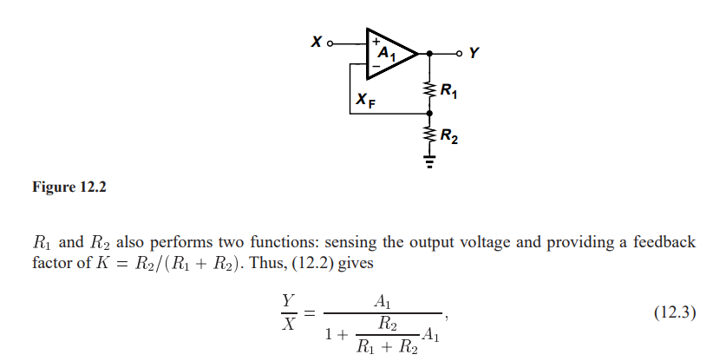

Slide 4
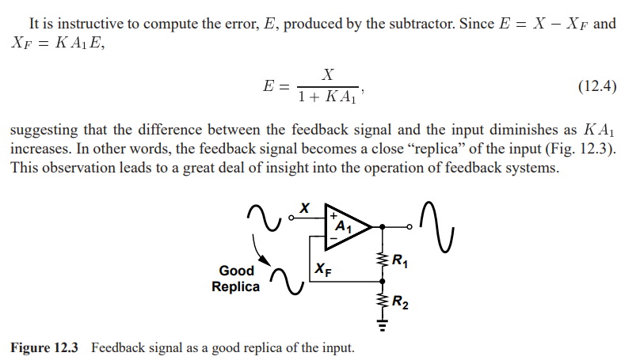

Slide 5
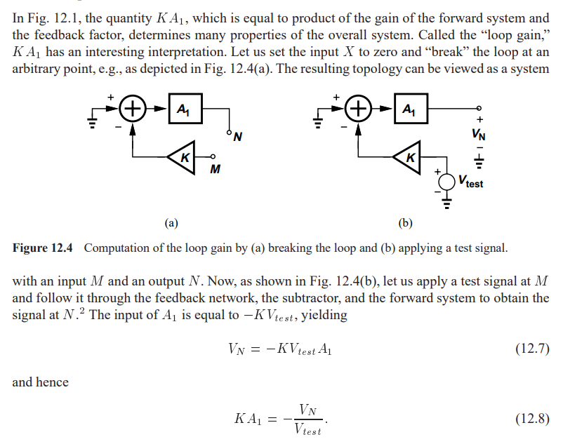
Loop Gain

Slide 6
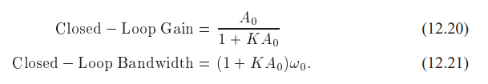
Properties of Negative Feedback
Gain Desensitization
Y/X = 1/K
Bandwidth Extension
Input and Output Impedance
Output impedance decreases

Slide 7
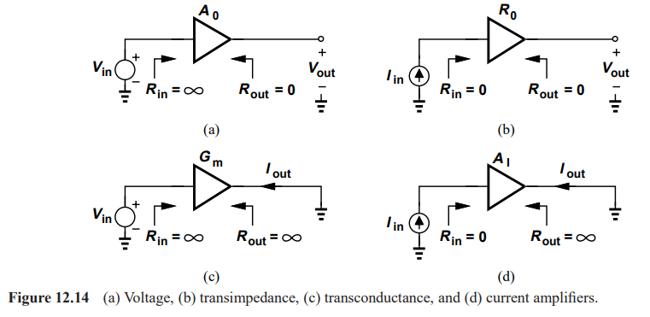
Types of Amplifiers

Slide 8
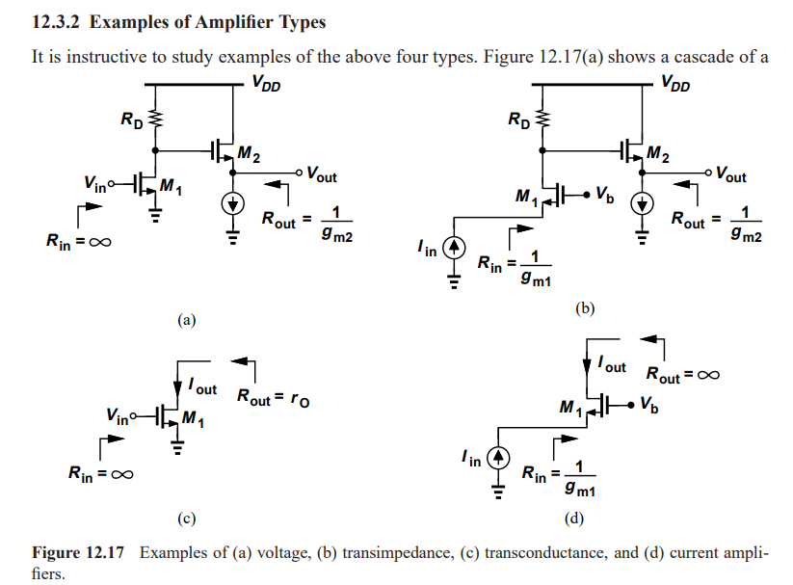

Slide 9
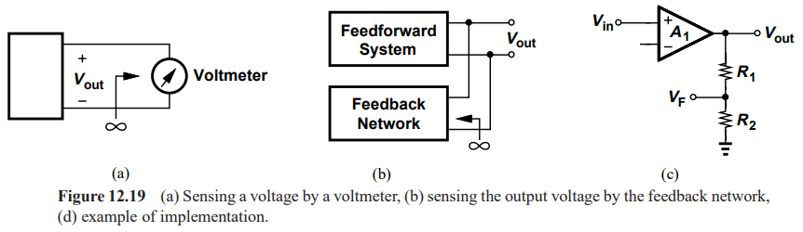
Sense and Return Techniques

Slide 10
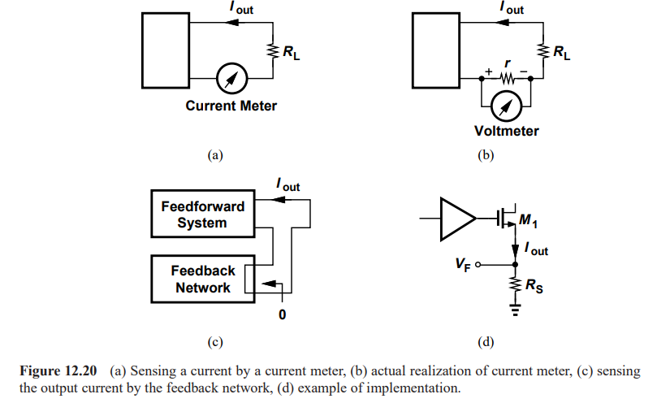

Slide 11
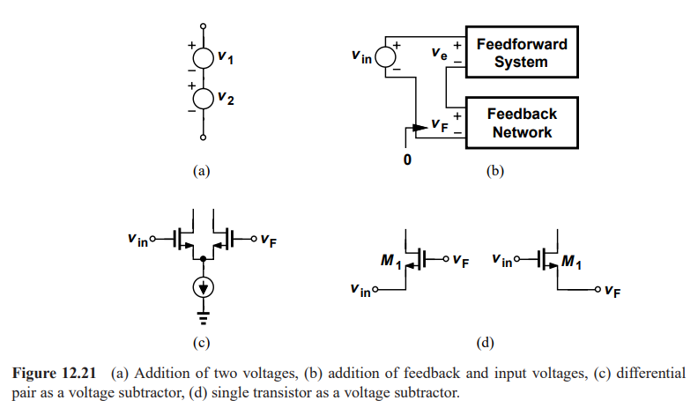

Slide 12
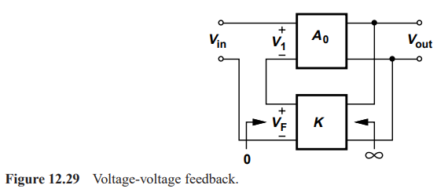
Feedback Topologies

Slide 13
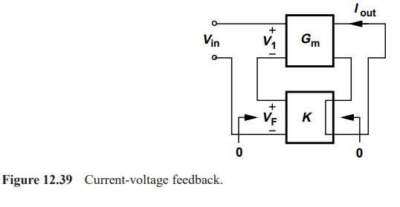

Slide 14
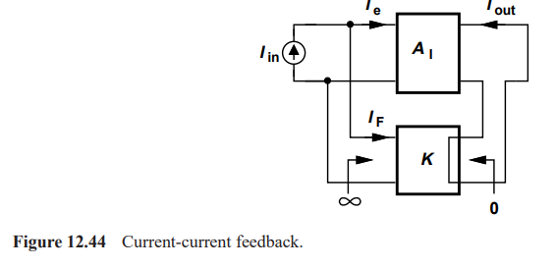

Slide 15
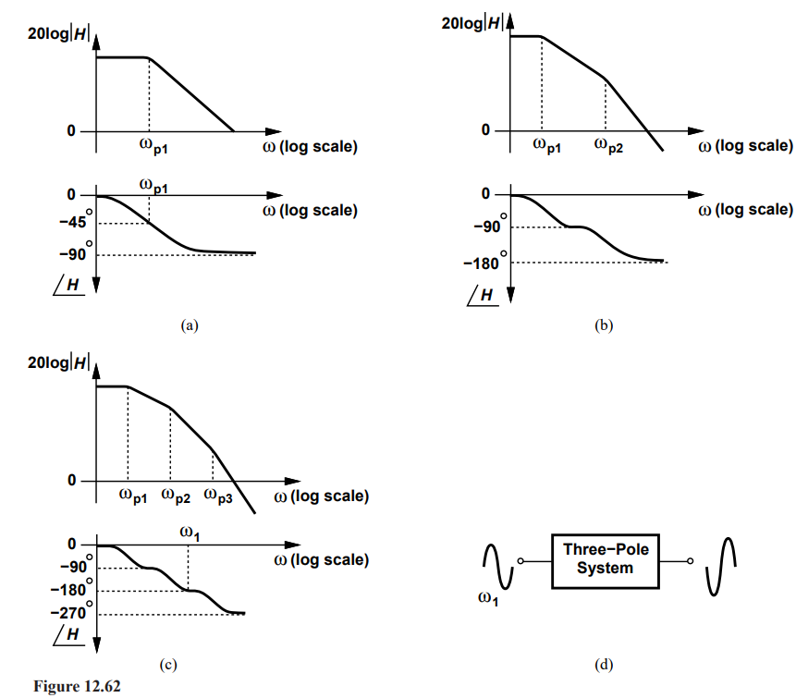

Stability in Feedback System

